Slide 1
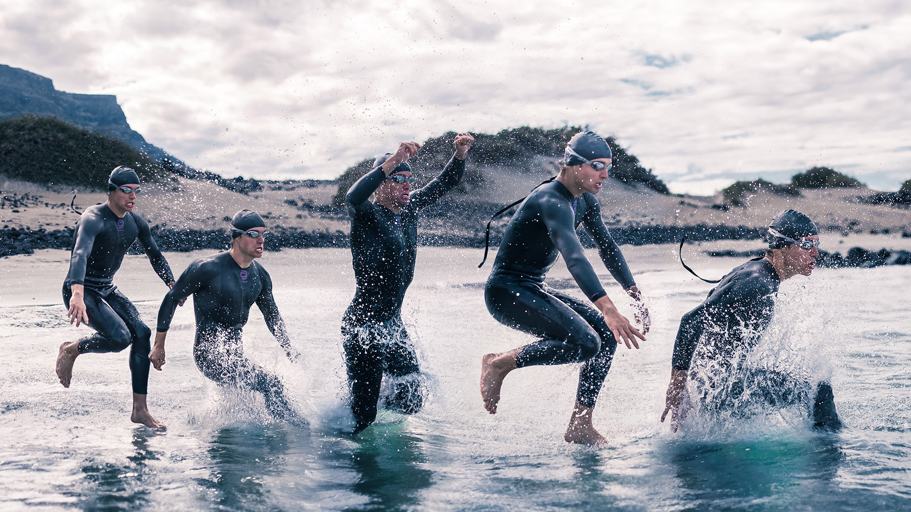
JOURNEY TO THE DOMINICAN REPUBLIC

Slide 2
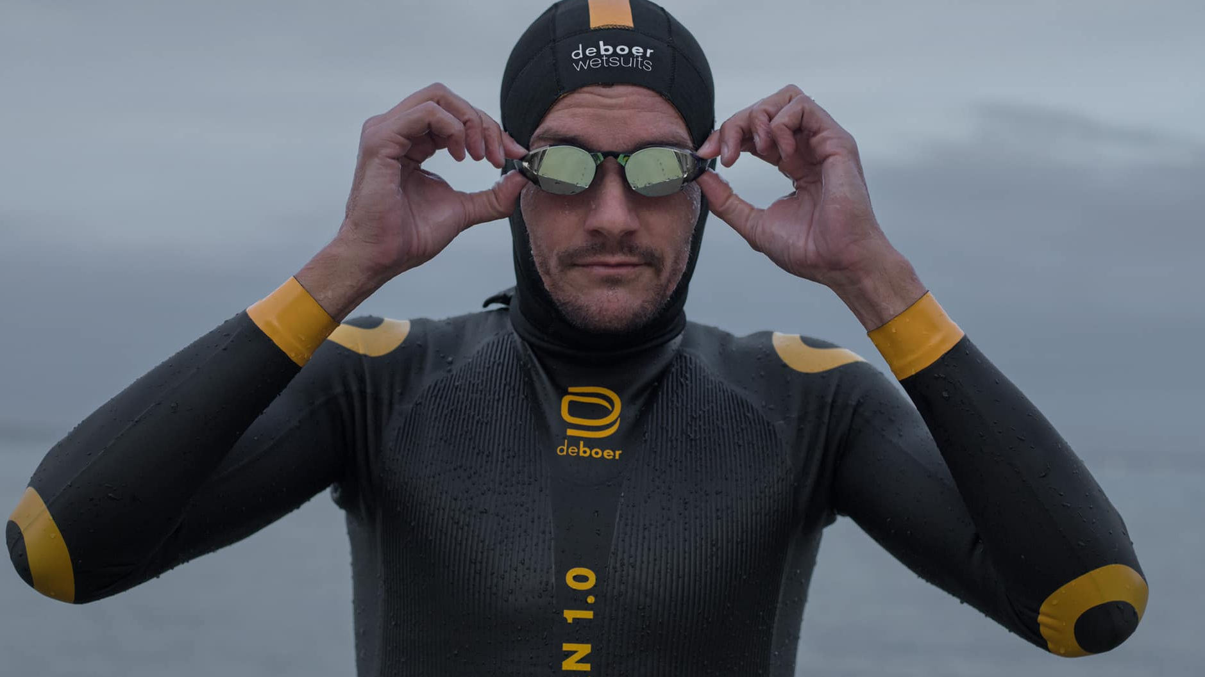
Simply the BEST wetsuits in the world

Slide 3
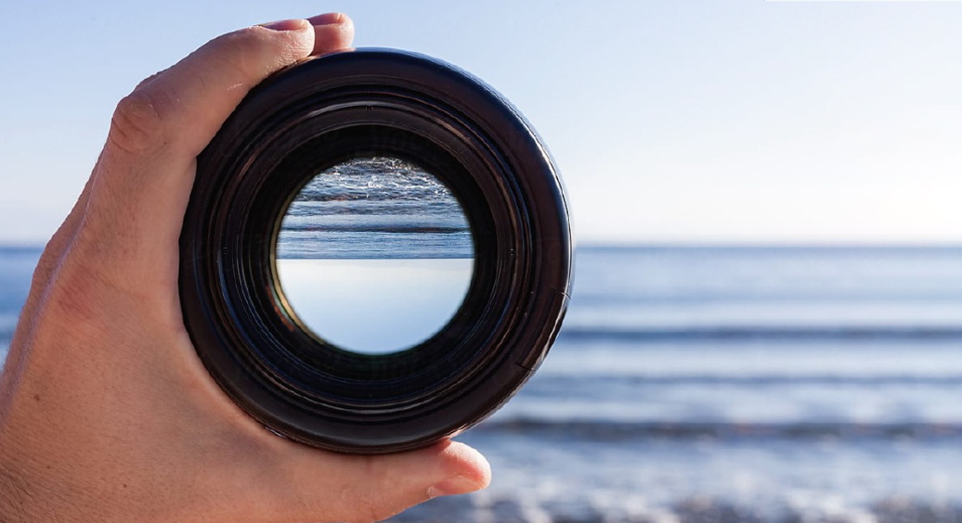
Brands of the future are:
FOCUSED

Slide 4
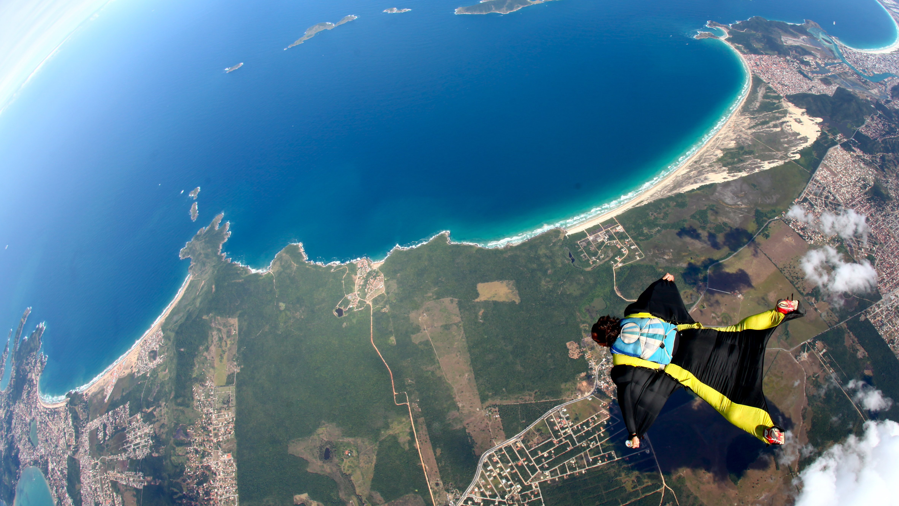
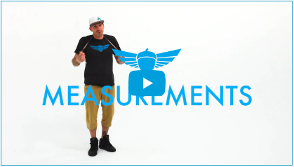
Brands of the future are:
CUSTOMER-CENTRIC

Slide 5
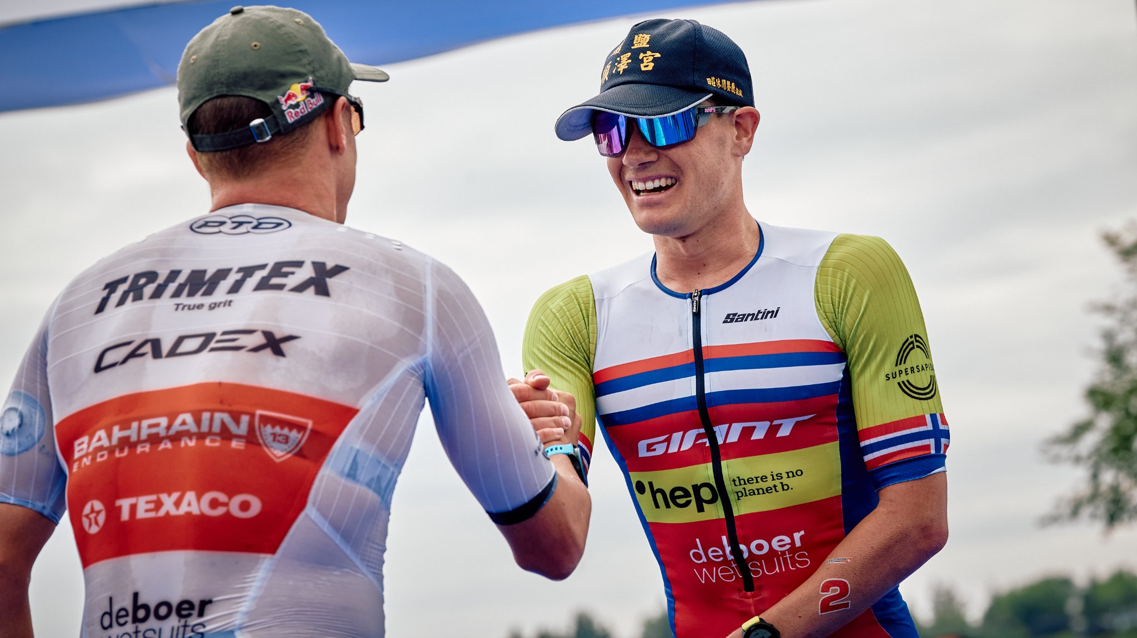
Brands of the future are:
MARKET-SAVVY

Slide 6
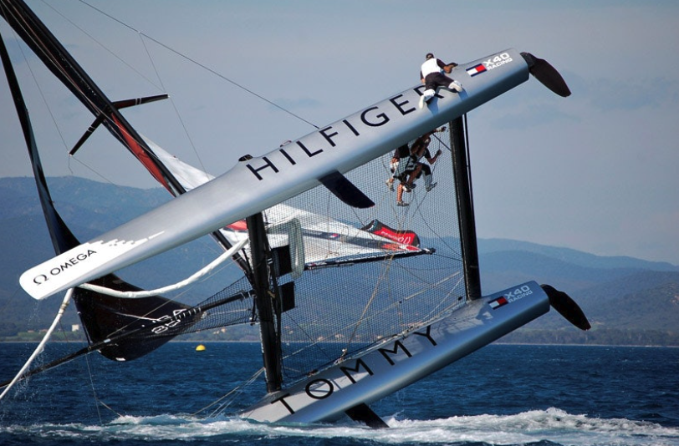
The Pandemic DISRUPTION

Slide 7
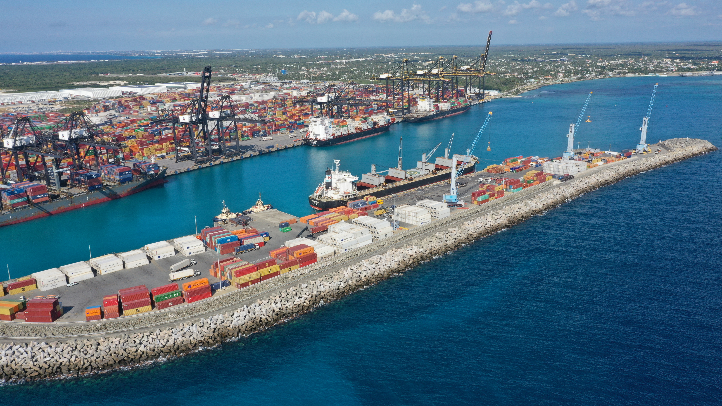
Why is the Dominican Republic right?
LOCATION, LOCATION, LOCATION

Slide 8
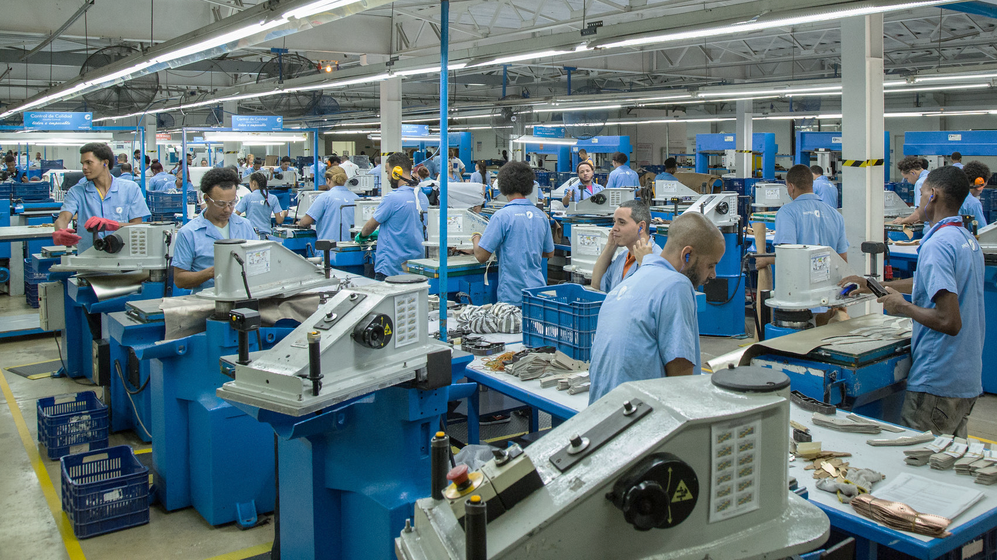
Why is the Dominican Republic right?
LABOR MARKET

Slide 9
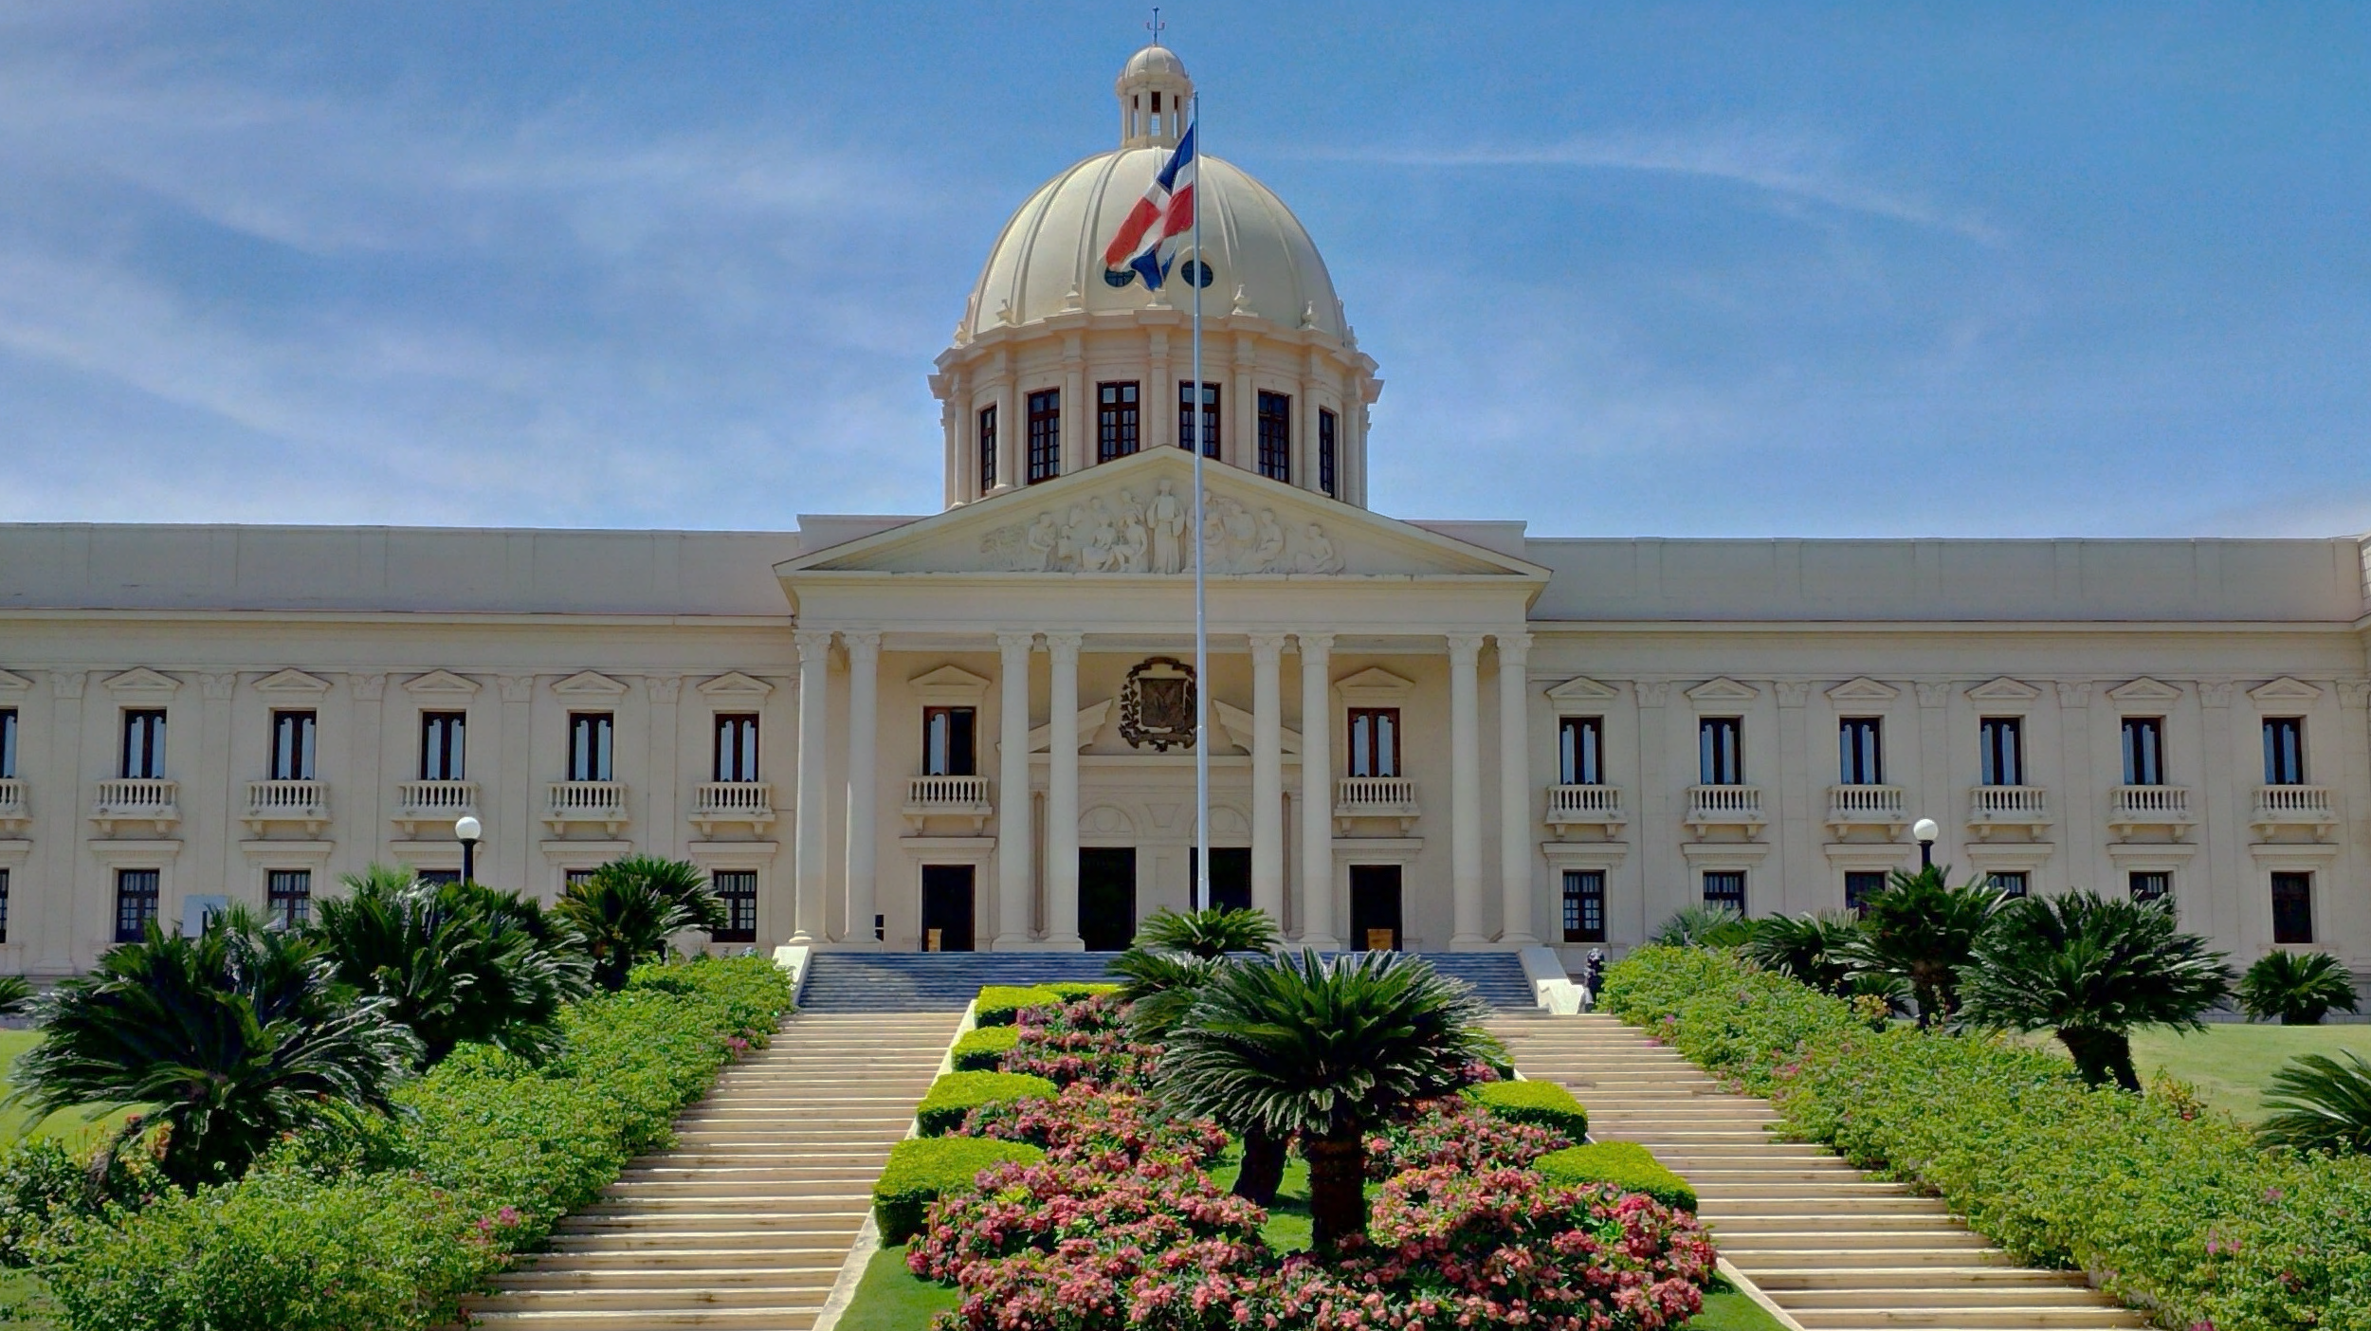
Why is the Dominican Republic right?
GOVERNMENT

Slide 10
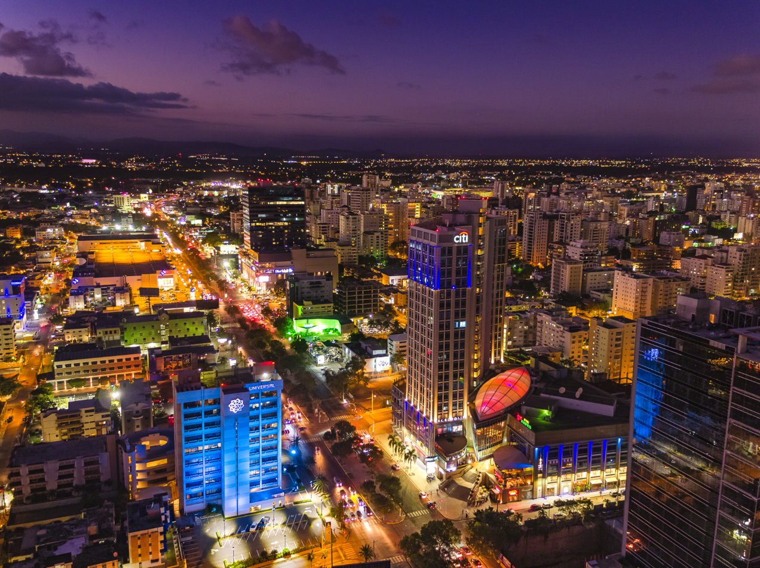
Why is the Dominican Republic right?
CAPITAL ACCESS

Slide 11
It’s not just the DR
The time is NOW for LATAM Free Zones

